Slide 1
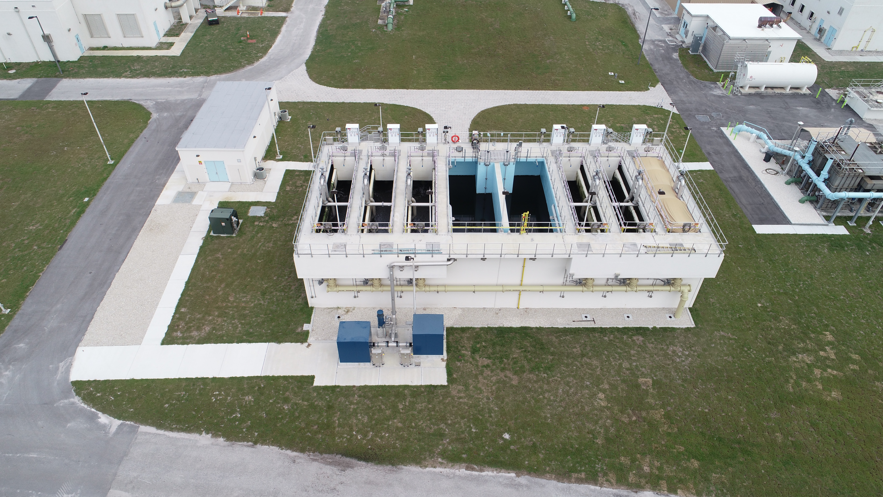
Loxahatchee Deep Bed Filter Performance Evaluation

Slide 2
Purpose of Today’s Meeting
Review data analysis/results from filter study
Discuss plan for developing full paper and conference abstracts
Discuss plan and needs for board-level version of this presentation

Slide 3
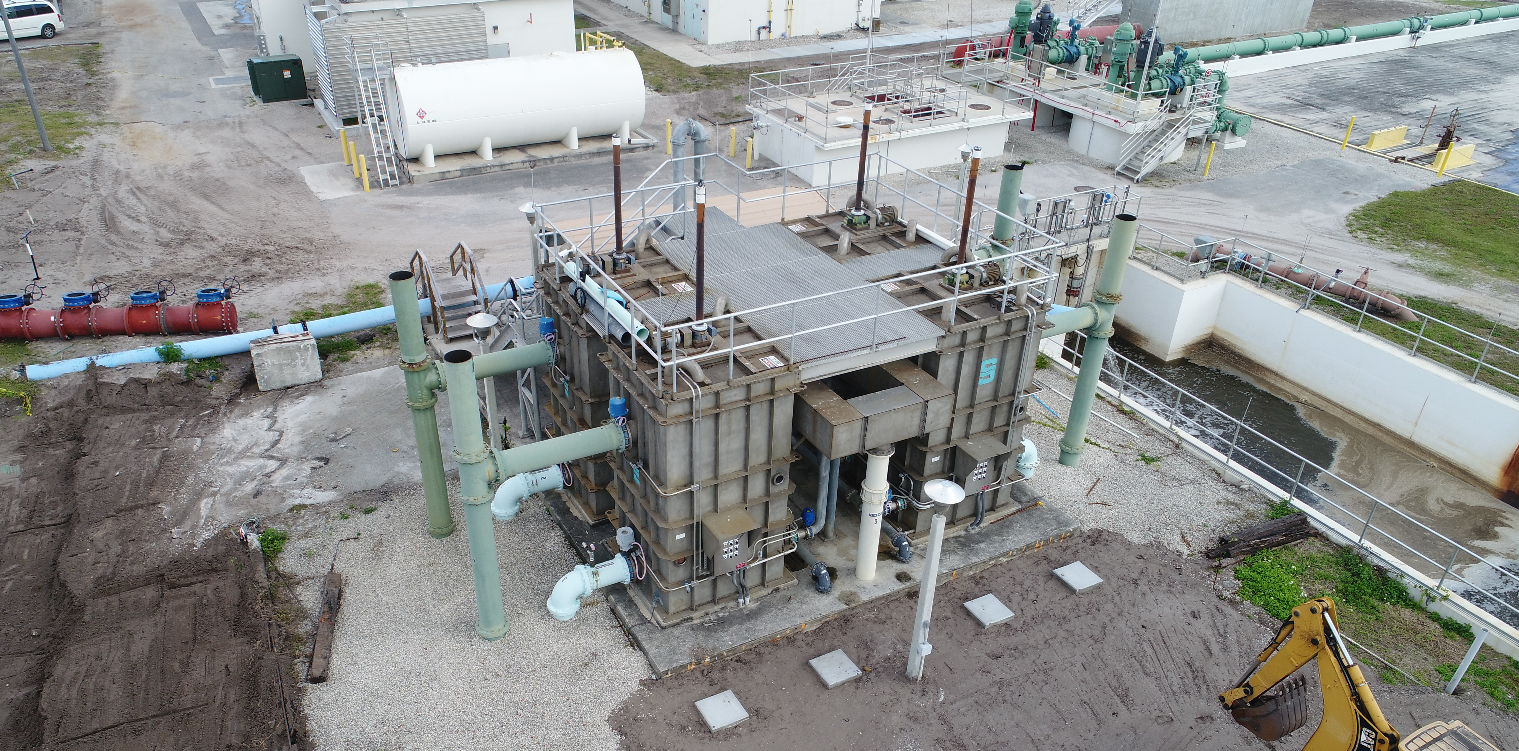
Project History
The Loxahatchee filter upgrade provided an opportunity to evaluate different filter types and their effectiveness in removal of TSS, pathogens, and contaminants of emerging concern (CECs)

Slide 4
Project History
The Loxahatchee filter upgrade provided an opportunity to evaluate different filter types and their effectiveness in removal of TSS, pathogens, and contaminants of emerging concern (CECs)
Phase 1: Traveling Bed Filters (TBF) and Synthetic Media Filters (SMF)
CEC Sampling: Jan – Apr 2016
Timeline
Phase 2: Upgrade to Deep Bed Filters (DBF)
CEC Sampling: Mar 2018 – May 2019

Slide 5
Project Objectives
Improve operational performance for creation of high quality reuse water
Key parameters are TSS and turbidity
Analyze the impact of filter upgrade on contaminants of concern (CECs) and pathogens
Analyze biodegradability and sorption to filter media and chlorine oxidation impacts removal of CECs

Slide 6
Project Objectives
Improve filter performance for operational parameters like TSS and turbidity
Analyze the impact of filter upgrade on contaminants of concern (CECs) and pathogens
Analyze biodegradability and sorption to filter media and chlorine oxidation impacts removal of CECs
Key analytes categorized by chlorine oxidation
Chlorine Oxidation:
Destruction of parent molecule from reactions with free chlorine (Cl₂, OCl⁻, or HOCl)
Poor Chlorine Oxidation | Moderate Chlorine Oxidation | Good Chlorine Oxidation
Carbamazepine Meprobamate Fluoxetine Ibuprofen TCEP TCPP Dilantin | Gemfibrozil | Salicylic Acid Caffeine Sulfamethoxazole Acetaminophen Triclosan

Slide 7
Project Objectives
Improve filter performance for operational parameters like TSS and turbidity
Analyze the impact of filter upgrade on contaminants of concern (CECs) and pathogens
Analyze biodegradability and sorption to filter media and chlorine oxidation impacts removal of CECs
Key analytes categorized by sorption and biodegradation
 | Poor Sorption | Good Sorption
Poor Biodegradation | Meprobamate Dilantin Sulfamethoxazole | TCEP TCPP Carbamazepine
Good Biodegradation | Salicylic Acid Gemfibrozil Ibuprofen | Acetaminophen Bisphenol-A Triclosan Caffeine Fluoxetine
Biodegradation:
Destruction of parent compound by microbial action
Sorption:
Attachment of parent compound to active sites on solid substrate

Slide 8
Impact on Operations: TSS and Turbidity Analysis

Slide 9
Methods to Evaluate Operational Improvements: Two-Sample t Test
SMF + TBF
DBF
Mean TSS Removal for SMF + TBF
Mean TSS Removal for DBF (unknown)
?
Two-Sample t Test evaluates whether the difference between these means is statistically significant

Slide 10
Upgrading to DBF Increased TSS Removal by Over 7.5%
SMF + TBF
DBF
Based on a Two Sample t-Test, estimated TSS removal is significantly different after DBF comes online
p-value (TSS): 4.4 x 10⁻¹⁹⁸
where p-value < 0.05 is significant

Slide 11
Average Effluent TSS Dropped Over 40% with DBF
SMF + TBF
DBF
Worse
Better

Slide 12
Average Effluent Turbidity Dropped Nearly 25% with DBF
SMF + TBF
DBF
SMF + TBF
DBF

Slide 13
Upgrading to DBF Significantly Reduced Effluent TSS and Turbidity
SMF + TBF
DBF
Based on a Two Sample t-Test, the mean TSS and turbidity are significantly different after DBF comes online
p-value (TSS): 4.5 x 10⁻²¹²
p-value (turbidity): 2.8 x 10⁻⁷⁸
where p-value < 0.05 is significant

Slide 14
Contaminants of Emerging Concern (CEC) Analysis

Slide 15
Methods to Evaluate CEC and Pathogen Removal: Boxplots to Compare Filter Types and CEC Attributes
Hypothetical data for SMF
No removal line

Slide 16
Methods to Evaluate CEC and Pathogen Removal: Boxplots to Compare Filter Types and CEC Attributes
Hypothetical data for SMF
3rd quartile
median
interquartile range
1st quartile

Slide 17
Methods to Evaluate CEC and Pathogen Removal: Boxplots to Compare Filter Types and CEC Attributes
Hypothetical data for SMF
data > 1.5 interquartile range
3rd quartile
median
No removal line
1st quartile
1.5 times interquartile range

Slide 18
Methods to Evaluate CEC and Pathogen Removal: Boxplots to Compare Filter Types and CEC Attributes
Hypothetical data
Key analytes categorized by sorption and biodegradation
 | Poor Sorption | Good Sorption
Poor Biodegradation | Meprobamate Dilantin Sulfamethoxazole | TCEP TCPP Carbamazepine
Good Biodegradation | Salicylic Acid Gemfibrozil Ibuprofen | Acetaminophen Bisphenol-A Triclosan Caffeine Fluoxetine
Good sorption and good biodegradation?
Poor sorption and poor biodegradation?

Slide 19
CECs Removal Near Zero across Filtration for All Filter Types
Full extent of removal data

Slide 20
Based on Data Evaluation, Sorption Does Not Explain CEC Removal
 | Poor Sorption | Good Sorption
 | Meprobamate Dilantin Sulfamethoxazole | TCEP TCPP Carbamazepine
 | Salicylic Acid Gemfibrozil Ibuprofen | Acetaminophen Bisphenol-A Triclosan Caffeine Fluoxetine

Slide 21
Biodegradability Not Explanatory for Removal; Dynamic WW Flow and Concentration Impact Observed Removal
Poor Biodegradation | Meprobamate Dilantin Sulfamethoxazole | TCEP TCPP Carbamazepine
Good Biodegradation | Salicylic Acid Gemfibrozil Ibuprofen | Acetaminophen Bisphenol-A Triclosan Caffeine Fluoxetine

Slide 22
Sorption and Biodegradability Not Explanatory for Removal
 | Poor Sorption | Good Sorption
Poor Biodegradation | Meprobamate Dilantin Sulfamethoxazole | TCEP TCPP Carbamazepine
Good Biodegradation | Salicylic Acid Gemfibrozil Ibuprofen | Acetaminophen Bisphenol-A Triclosan Caffeine Fluoxetine

Slide 23
CECs Removal After Filtration is Low Because Chloramines is Used Instead of Free Chlorine
Full extent of removal data
Zoomed in view of removal data

Slide 24
It Is Unclear Whether Chlorine Oxidation Category Is Explanatory for Removal
Poor Chlorine Oxidation | Moderate Chlorine Oxidation | Good Chlorine Oxidation
Carbamazepine Meprobamate Fluoxetine Ibuprofen TCEP TCPP Dilantin | Gemfibrozil | Salicylic Acid Caffeine Sulfamethoxazole Acetaminophen Triclosan

Slide 25
It Is Unclear Whether Chlorine Oxidation Category Is Explanatory for Removal

Slide 26
Triclosan Is Consistently Removed by Chlorine Oxidation
Within the “Good Chlorine Oxidation” category, Triclosan has the best removal performance.
Poor Chlorine Oxidation | Moderate Chlorine Oxidation | Good Chlorine Oxidation
Carbamazepine Meprobamate Fluoxetine Ibuprofen TCEP TCPP Dilantin | Gemfibrozil | Salicylic Acid Caffeine Sulfamethoxazole Acetaminophen Triclosan

Slide 27
Pathogen Analysis

Slide 28
Increased Removal of Pathogens Observed for DBF—Although Sample Sizes are Small
n = 7
n = 7
n = 6
n = 7
n = 7
n = 6

Slide 29
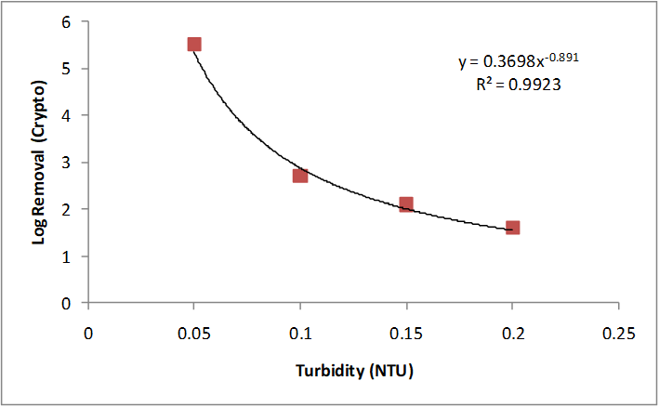
Pathogen Reduction Correlates to Turbidity Breakthrough
Unpublished data from Ian Douglas, City of Ottawa, Filter Study on Surface Water Treatment
SMF + TBF
DBF

Slide 30
Concluding Thoughts

Slide 31
Project Objectives
Improve filter performance for operational parameters like TSS and turbidity
Filter upgrade to DBF:
Increased TSS removal by 7.5%
Decreased effluent TSS by 40%
Decreased effluent turbidity by 25%

Slide 32
Project Objectives
Analyze the impact of filter upgrade on contaminants of concern (CECs) and pathogens
Filter upgrade to DBF:
Had no observable impact on CEC removal
Increased removal of Cryptosporidium and Giardia

Slide 33
Project Objectives
Analyze biodegradability and sorption to filter media and chlorine oxidation impacts removal of CECs
Neither biodegradability nor sorption category has an impact on CEC removal
However, chlorine oxidation category may have an impact on CEC removal
Poor sorption,
Poor biodegradation
Poor sorption,
Good biodegradation
Good sorption,
Poor biodegradation
Good sorption,
Good biodegradation

Slide 34
Additional Slides

Slide 35
Upgrading to DBF Significantly Reduced TSS and Turbidity Based on Two-Sample t Test
SMF + TBF
Transition
DBF

Slide 36
Upgrading to DBF Significantly Reduced TSS and Turbidity Based on Two-Sample t Test
SMF + TBF
Transition
DBF
SMF + TBF
Transition
DBF

Slide 37
Upgrading to DBF Significantly Reduced TSS and Turbidity Based on Two-Sample t Test
SMF + TBF
Transition
DBF
Based on a Two Sample t-Test, the mean TSS and turbidity are significantly different after DBF comes online
p-value (TSS): 1.06 x 10⁻⁴²
p-value (turbidity): 1.48 x 10⁻⁶¹
where p-value < 0.05 is significant

Slide 38
Methodology and Assumptions
Non-detects are set to the minimum reporting level (MRL) of instrument.
Flow split assumption: based on SCADA data, calculations were made assuming an average of 1.71 MGD to traveling bed filters and 6.25 MGD to synthetic media filters.
For triplicate data, the mean value was used (analysis of variability shown below).

Slide 39
DBF Shows Slight Increase in Average Turbidity Removal Compared to SMF and TBF
n = 29
n = 56
n = 15

